Slide 1
Thinking about high dimensional data
Machine Learning for Single Cell Analysis
Day 1 – Morning session

Slide 2
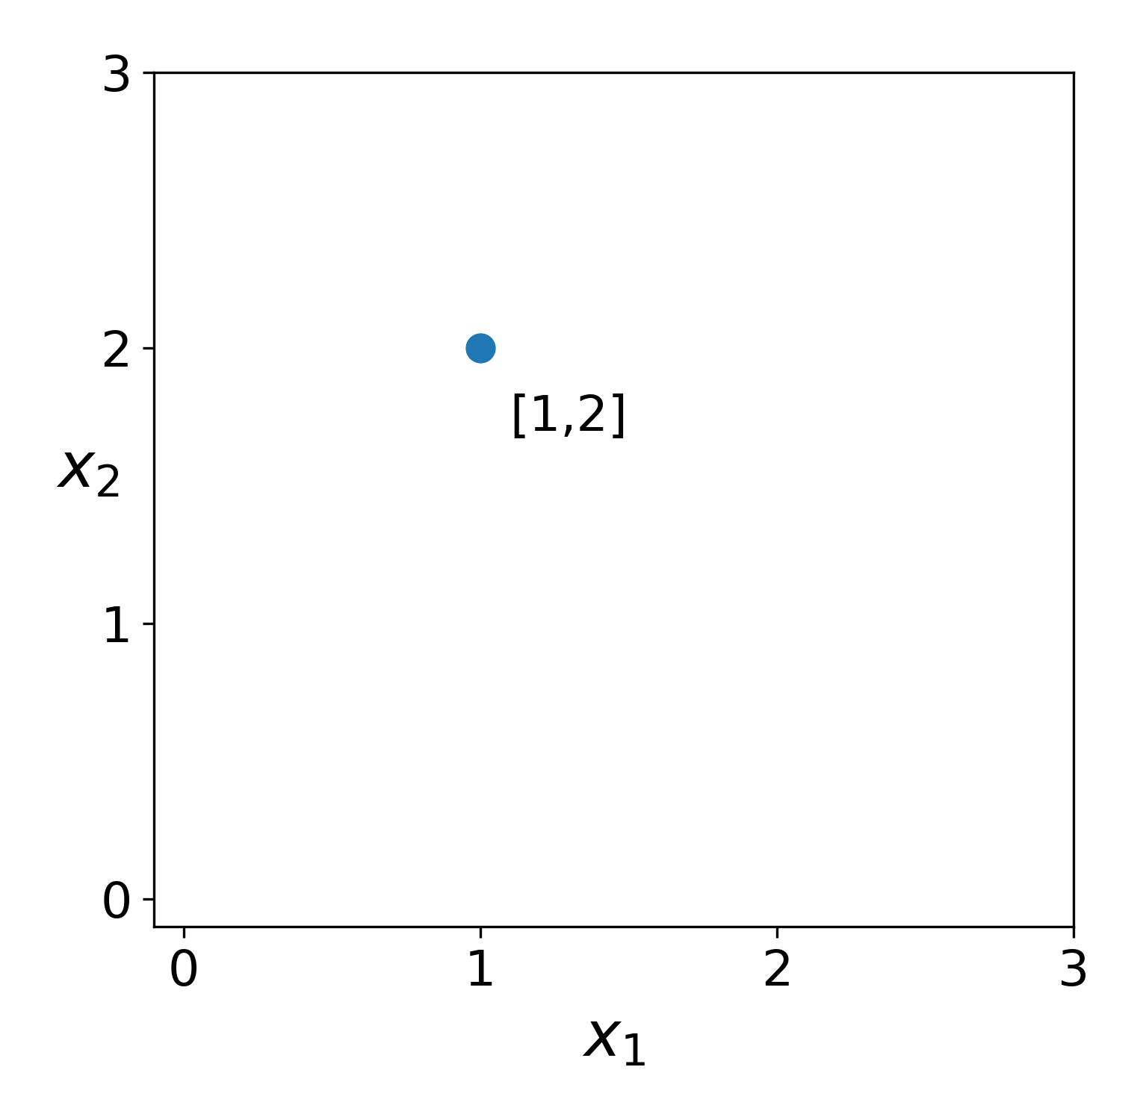
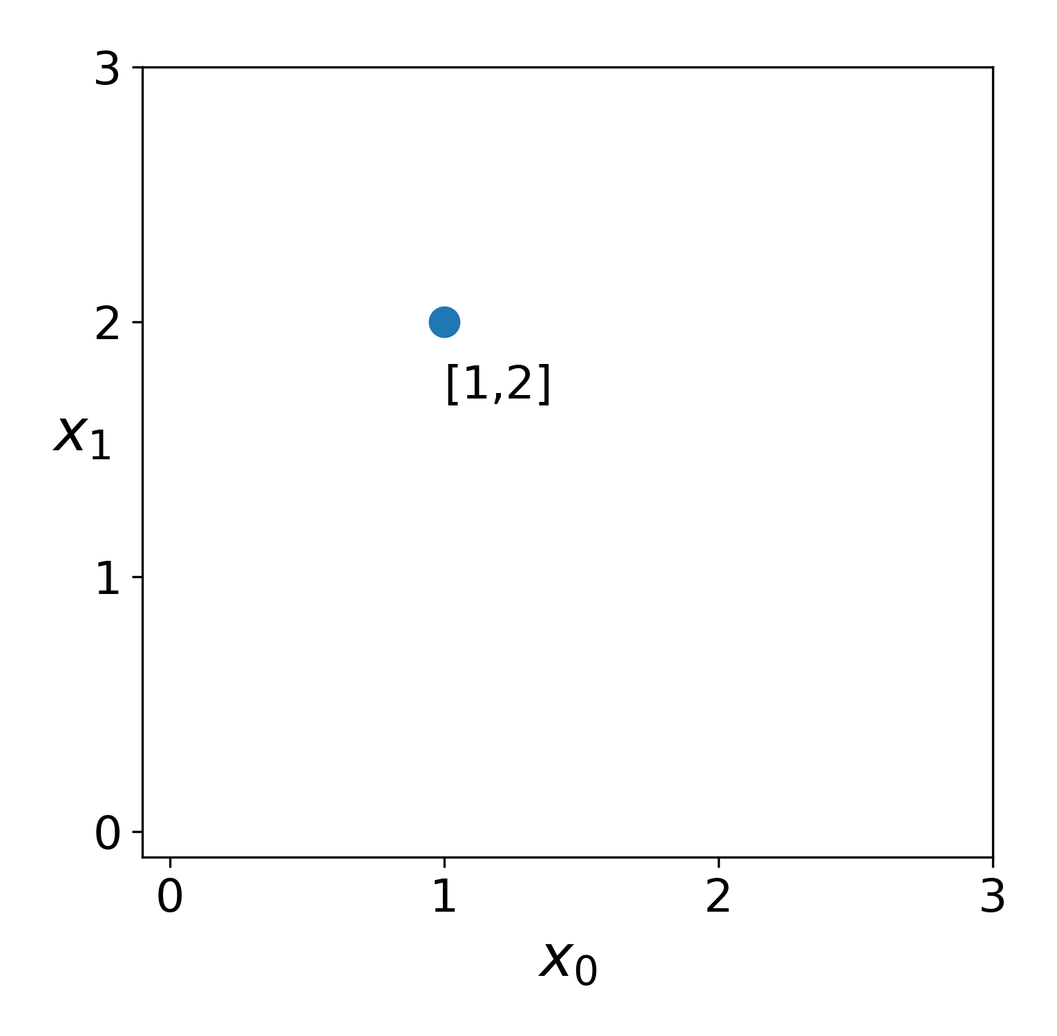
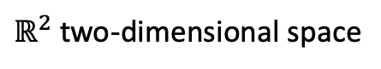

What does “dimensionality” mean?
$ℝ^{2}$ two-dimensional space
$$a$$

Slide 3
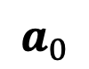
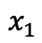
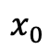
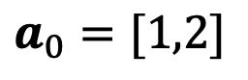
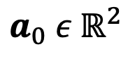
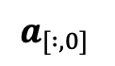
What does “dimensionality” mean?
vector
coordinate space
$ℝ^{2}$ two-dimensional space
$$a_{0} ε{ ℝ}^{2}$$
$$a_{0}=[1,2]$$
$$a_{0}$$
$$x_{0}$$
$$x_{1}$$
features
$$a_{[ :,0]}$$

Slide 4
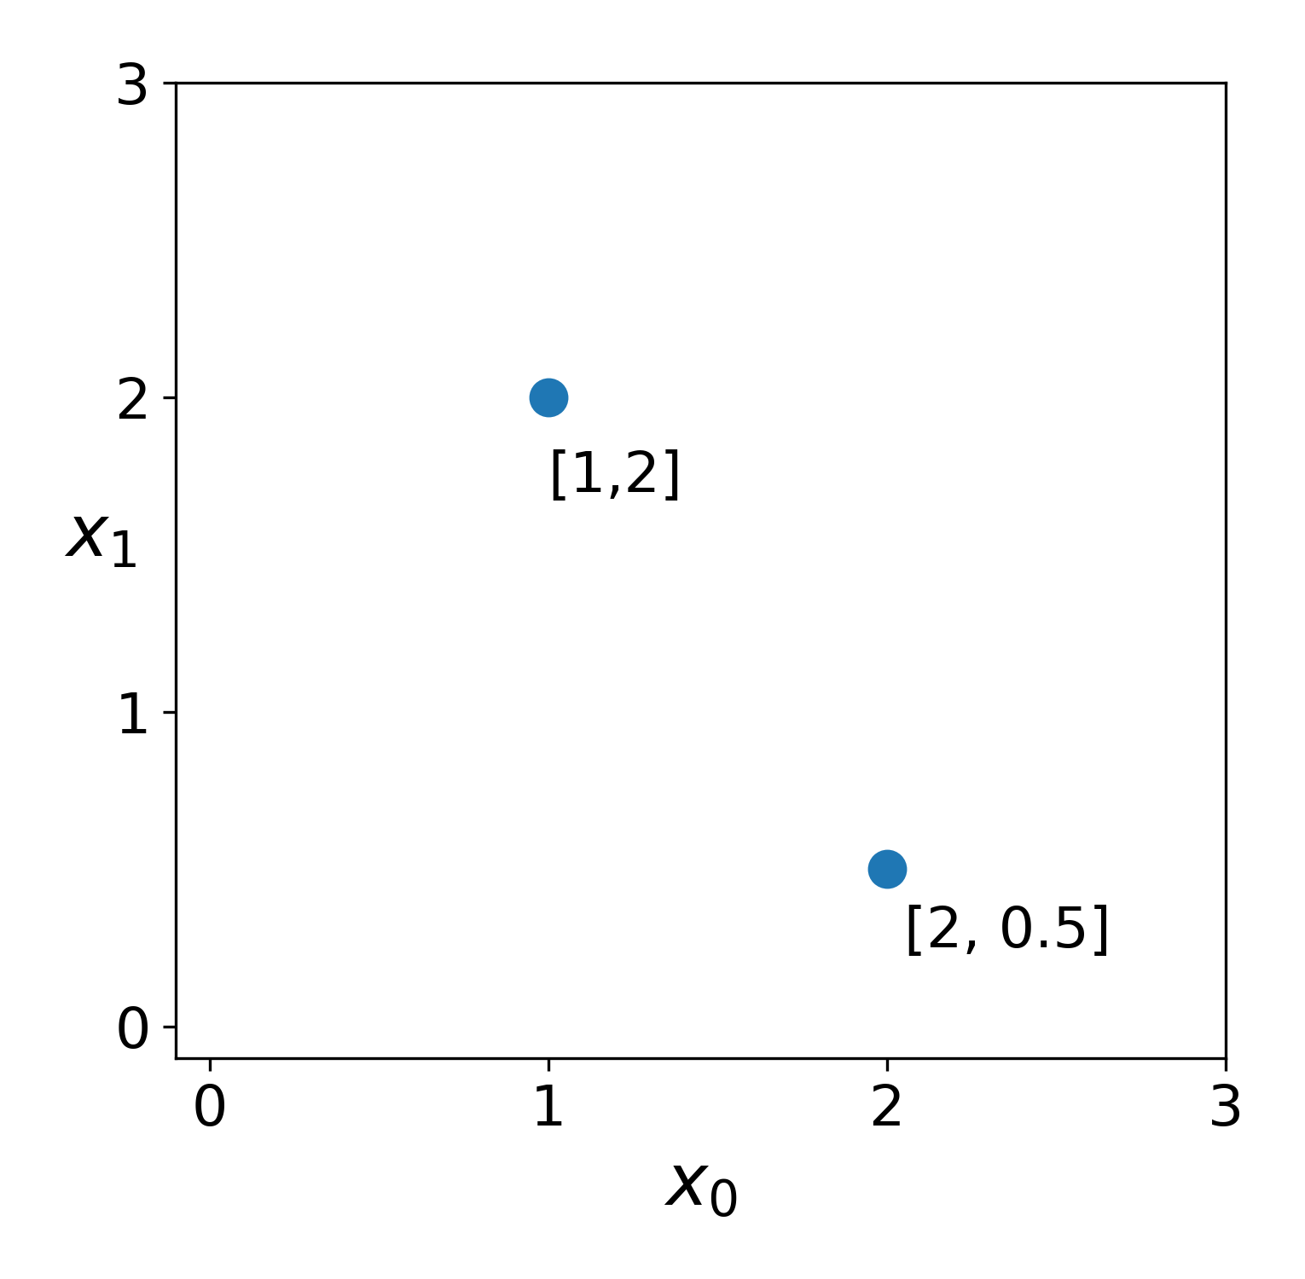
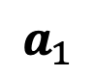
What does “dimensionality” mean?
vector
coordinate space
$ℝ^{2}$ two-dimensional space
$$a_{0} ε{ ℝ}^{2}$$
$$a_{0}=[1,2]$$
$$a_{0}$$
$$x_{0}$$
$$x_{1}$$
features
$$a_{1}$$
$$a_{[ :,0]}$$

Slide 5
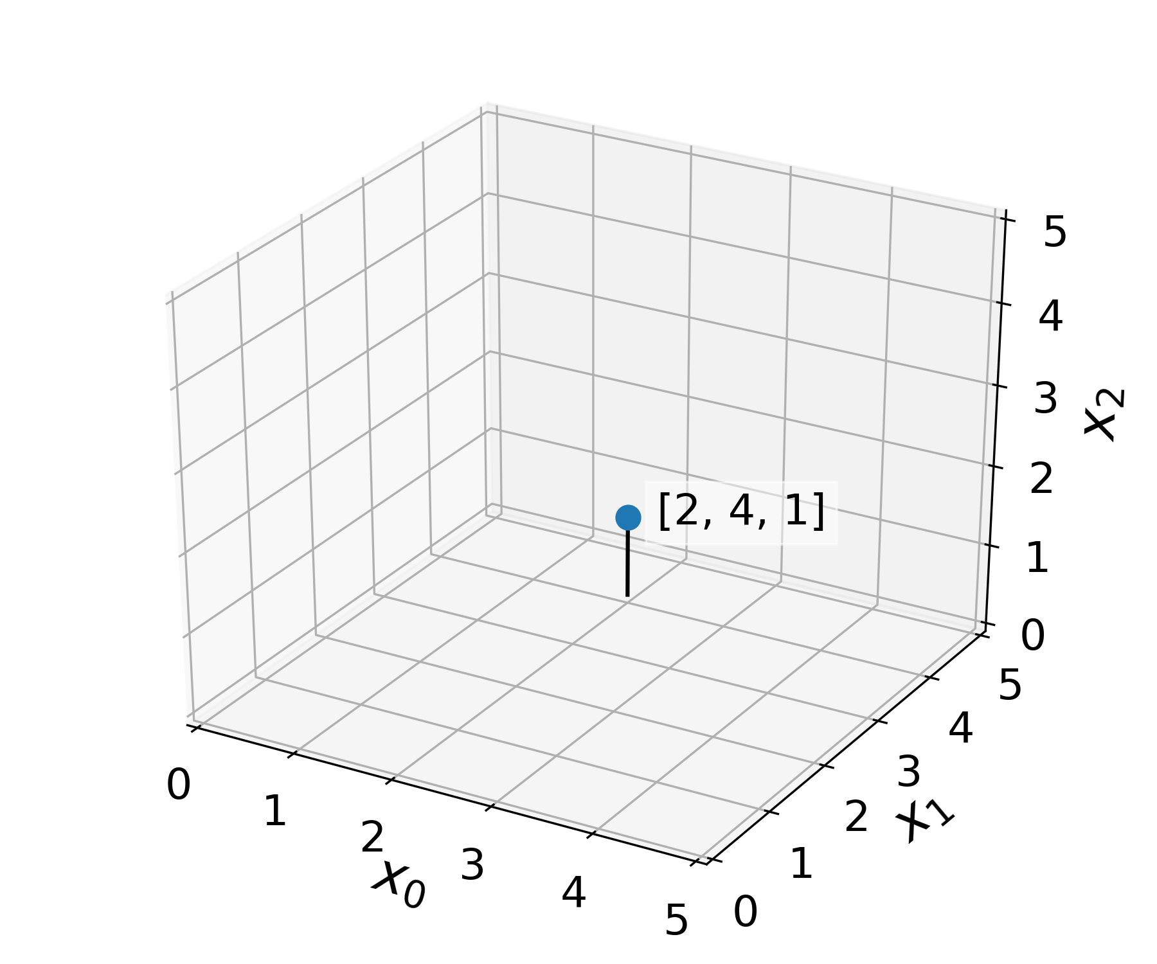
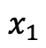
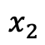
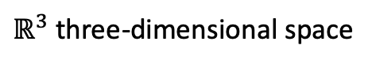
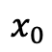
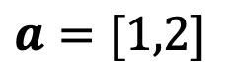
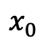
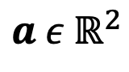
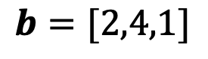

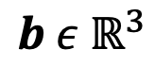
What does “dimensionality” mean?
$$a ε{ ℝ}^{2}$$
$ℝ^{3}$ three-dimensional space
$$a=[1,2]$$
$$x_{0}$$
$$x_{1}$$
$$b ε{ ℝ}^{3}$$
$$b=[2,4,1]$$
$$b$$
$$x_{0}$$
$$x_{1}$$
$$x_{2}$$

Slide 6
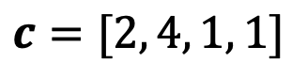
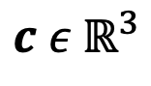
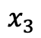
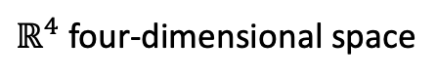
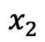
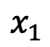
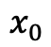
What does “dimensionality” mean?
$$a ε{ ℝ}^{2}$$
$ℝ^{4}$ four-dimensional space
$$a=[1,2]$$
$$x_{0}$$
$$x_{1}$$
$$b ε{ ℝ}^{3}$$
???
$$b=[2,4,1]$$
$$x_{0}$$
$$x_{1}$$
$$x_{2}$$
$$c ε{ ℝ}^{3}$$
$$c=[2, 4, 1, 1]$$
$$x_{0}$$
$$x_{1}$$
$$x_{2}$$
$$x_{3}$$

Slide 7
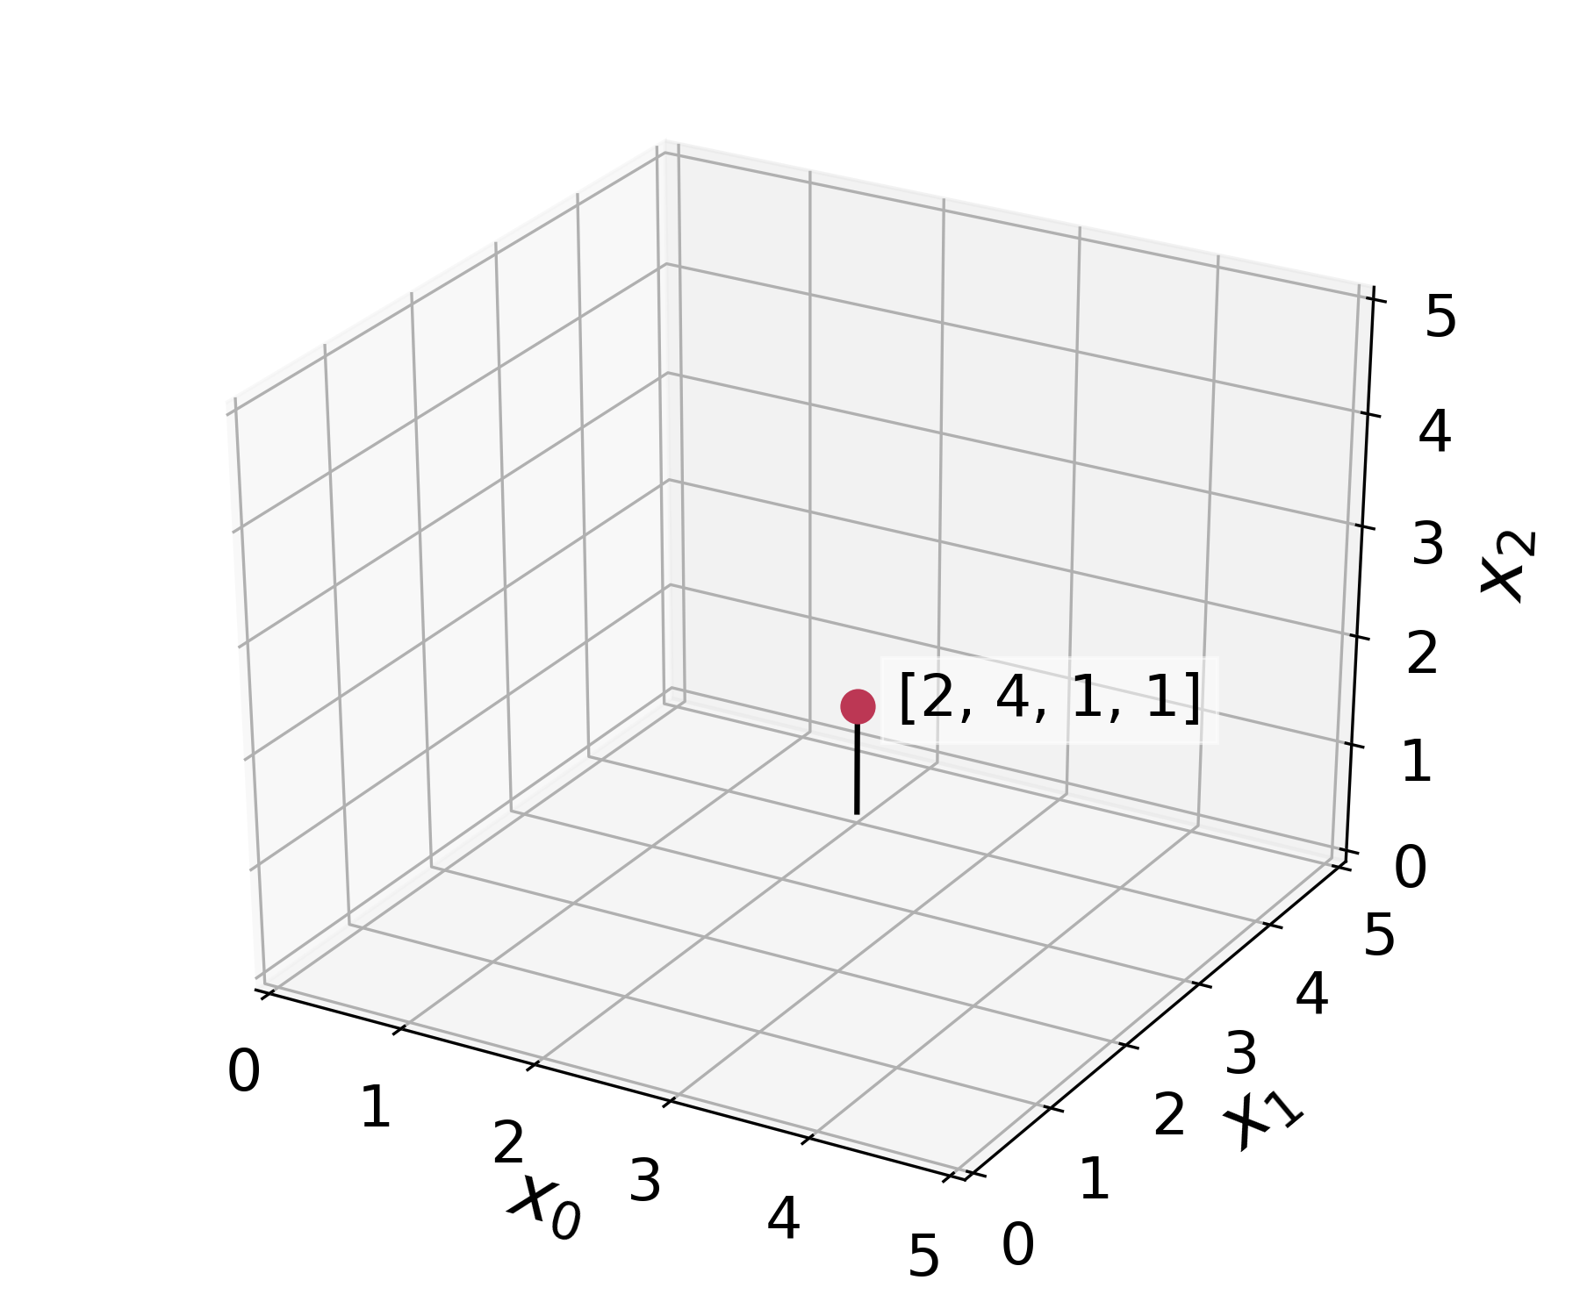


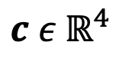
What does “dimensionality” mean?
$$a ε{ ℝ}^{2}$$
$ℝ^{4}$ four-dimensional space
$$a=[1,2]$$
x₃
2
$$x_{0}$$
$$x_{1}$$
$$b ε{ ℝ}^{3}$$
$$b=[2,4,1]$$
$$c$$
1
$$x_{0}$$
$$x_{1}$$
$$x_{2}$$
$$c ε{ ℝ}^{4}$$
0
$$c=[2, 4, 1, 1]$$
$$x_{0}$$
$$x_{1}$$
$$x_{2}$$
$$x_{3}$$

Slide 8
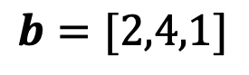
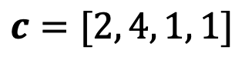
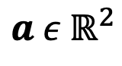
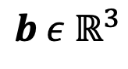
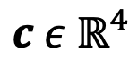
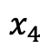
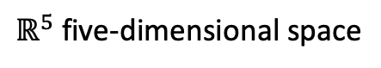
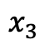
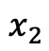
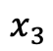
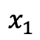
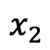
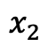
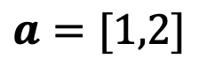
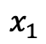
What does “dimensionality” mean?
$ℝ^{5}$ five-dimensional space
$$a ε{ ℝ}^{2}$$
$$a=[1,2]$$
$$x_{1}$$
$$x_{2}$$
$$b ε{ ℝ}^{3}$$
???
$$b=[2,4,1]$$
$$x_{1}$$
$$x_{2}$$
$$x_{3}$$
$$c ε{ ℝ}^{4}$$
$$c=[2, 4, 1, 1]$$
$$x_{1}$$
$$x_{2}$$
$$x_{3}$$
$$x_{4}$$

Slide 9
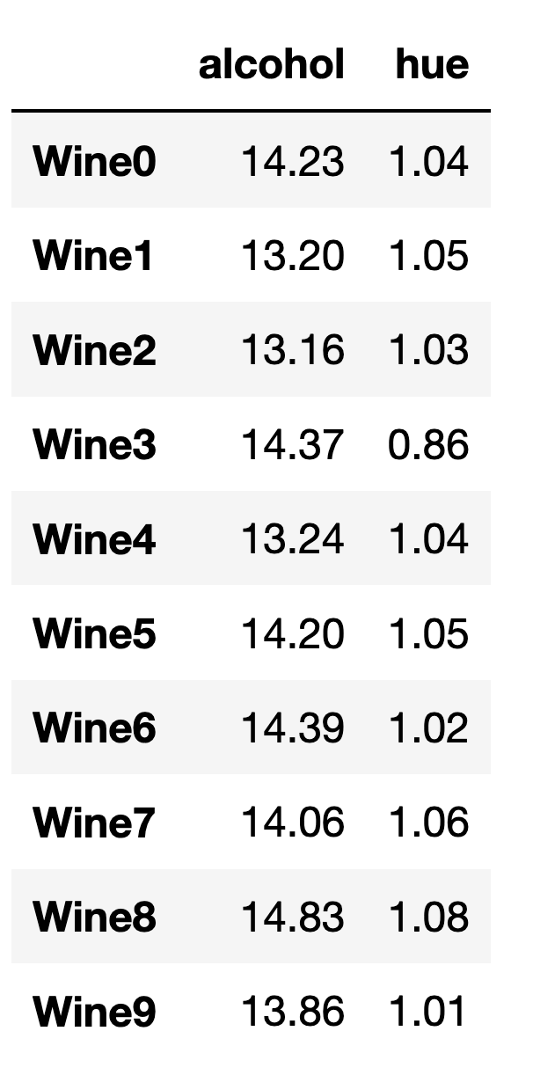
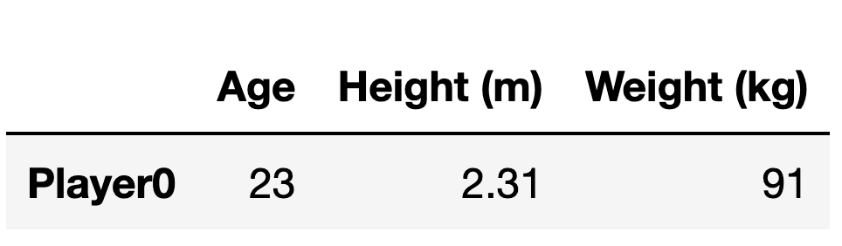
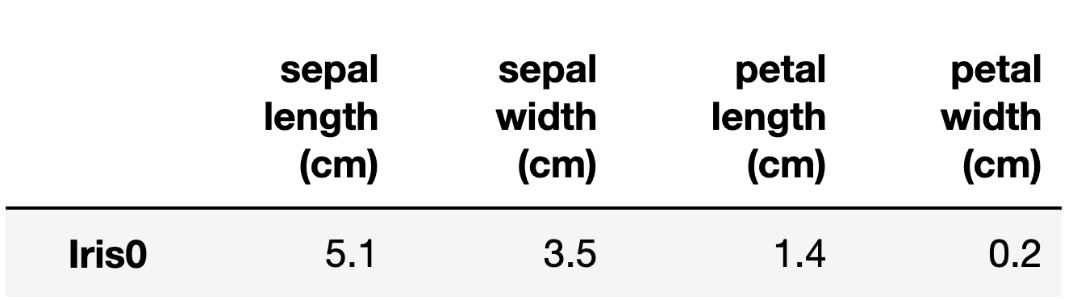
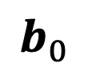
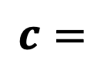






What do x₁ x₂, …, x_{n} represent?
We describe coordinate spaces of $n$ dimensions as $ℝ^{n}$
$$a=$$
$$b=$$
$$a_{0}$$
$$a_{1}$$
$$b_{0}$$
$$b_{1}$$
$$b_{2}$$
$$c=$$
UCI ML Wine Data Set

Slide 10




What if we have more than one observation?
columns (features)
$$a=$$
$$a_{0}$$
$$a_{1}$$
$$A=$$
rows
(observations)
matrix
UCI ML Wine Data Set

Slide 11

What if we have more than one observation?
columns (features)
$$a=$$
$$a_{0}$$
$$a_{1}$$
$$A=$$
$$ε{ ℝ}^{2}$$
matrix
UCI ML Wine Data Set

Slide 12





How do we reference specific observations in a matrix?
$$x_{0}$$
$$x_{1}$$
$$A_{\left[0, :\right]}$$
$$A_{\left[row, column\right]}$$
$$A=$$

Slide 13






What if we have more than one observation?
We can describe coordinate spaces of $n$ dimensions as $ℝ^{n}$
$$x_{0}$$
$$x_{1}$$
$$A_{\left[0, :\right]}=a_{0}=$$
$$A_{\left[0,0\right]}$$
$$A_{\left[0,1\right]}$$
$$A=$$

Slide 14




What if we have more than one observation?
We can describe coordinate spaces of $n$ dimensions as $ℝ^{n}$
$$x_{0}$$
$$x_{1}$$
$$A_{\left[0, :\right]}=$$
$$A_{\left[0,0\right]}$$
$$A_{\left[0,1\right]}$$
$$A=$$
$$A_{\left[9, :\right]}=$$
$$A_{\left[9,1\right]}$$
$$A_{\left[9,1\right]}$$

Slide 15

Exercise!
Loading and plotting the UCI wine dataset

Slide 16

Exercise!
Loading and plotting the UCI wine dataset

Slide 17
Introducing scprep
Code: https://github.com/KrishnaswamyLab/scprep
Docs: https://scprep.readthedocs.io
Modules
filter
io
measure
normalize
plot
reduce
run
select
stats
transform
utils
Plotting functions:
histogram
jitter
marker
marker_plot
plot_gene_set_expression
plot_library_size
rotate_scatter3d
scatter
scatter2d
scatter3d
scree
scree_plot
= scprep.plot.scatter2d

Slide 18
Exercise!
Loading and plotting the UCI wine dataset

Slide 19


How do features differentiate groups within a dataset?

Slide 20
Introduction to Manifold Learning

Slide 21





How far away is each point from $a_{0}?$
$$a_{1}$$
$$a_{0}$$
$$a_{2}$$

Slide 22








How far away is each point from $a_{0}?$
Euclidean distance
$$a_{1}$$
$$d_{euclidean}\left(a_{0},a_{1}\right)= {\left\|a_{0}−a_{1}\right\|}_{2}^{2}$$
$$\text{2.24}$$
$$=\sqrt{{{(a}_{0,0} −a_{1,0})}^{2}+{{(a}_{0,1} −a_{1,1})}^{2}}$$
$$a_{0}$$
$$a_{2}$$
$$=\sqrt{{(1 −2)}^{2}+{(2 −4)}^{2}}$$
$$≈2\text{.24}$$

Slide 23




How far away is each point from $a_{0}?$
$$a_{1}$$
$$a_{0}$$
$$a_{2}$$

Slide 24
How far away is each point from $a_{0}?$
$$a_{1}$$
$$a_{0}$$
$$a_{2}$$

Slide 25


How far away is each point from $a_{0}?$
$$a_{1}$$
$$a_{0}$$
$$a_{2}$$

Slide 26
How far away is each point from $a_{0}?$
$$a_{1}$$
$$a_{0}$$
$$a_{2}$$

Slide 27







How far away is each point from $a_{0}?$
Manhattan distance
$$a_{1}$$
$$d_{manhattan}\left(a_{0},a_{1}\right)=|a_{0,1} −a_{1,1}|$$
$$={|a}_{0,0} −a_{1,0}|+|a_{0,1} −a_{1,1}|$$
$$a_{0}$$
$$a_{2}$$
$$=|1 −2|+|2−4|$$
$$=3$$

Slide 28





How far away is each point from $a_{0}?$
$$a_{1}$$
$$a_{1}$$
$$a_{2}$$
$$a_{2}$$
$$a_{0}$$
$$a_{0}$$

Slide 29

Exercise!
Calculating distances
Dist
Notes:
Are the green and orange cultivars really different? How could we tell?

Slide 30
Exercise!
Calculating distances
Distance defines structure in a dataset
How different are two data points?
How many types exist in my dataset?
Which types are closest to each other?
Which features vary between dissimilar groups of data?
Dist
Notes:
Are the green and orange cultivars really different? How could we tell?

Slide 31



What is a manifold?
Surface in $ℝ^{3}$
Local view in $ℝ^{2}$
Locally smooth
Locally Euclidean
Generally, lower dimensional than the ambient space (i.e. a subspace)
Notes:
Mention that the “manifold dimensionality” of this manifold is 2d

Slide 32




Examples of manifolds
Wolfram
Notes:
Mention that the “manifold dimensionality” of this manifold is 2d

Slide 33

Examples of manifolds
Waddington’s landscape
Wolfram
ptglab.com
Notes:
Mention that the “manifold dimensionality” of this manifold is 2d

Slide 34
Examples of manifolds
Waddington’s landscape
Smooth transitions between states
Small changes in gene expression are linear
Wolfram
ptglab.com
Notes:
Mention that the “manifold dimensionality” of this manifold is 2d

Slide 35

NHV
MEX
Notes:
Ask, what is the intrinsic dimensionality of a sphere?

Slide 36

How far is NHV -> MEX?

Slide 37

How far is NHV -> MEX?

Slide 38

How far is NHV -> MEX?

Slide 39
How far is NHV -> MEX?
Manifold distance
Euclidean distance

Slide 40

Is a circle locally Euclidean?

Slide 41

Is a circle locally Euclidean?
# segments = 2

Slide 42

Is a circle locally Euclidean?
# segments = 4

Slide 43

Is a circle locally Euclidean?
# segments = 100

Slide 44
Is a circle locally Euclidean?
Key Insight:
Manifolds are locally Euclidean,
but not globally Euclidean

Slide 45
Is a circle locally Euclidean?
Key Insight:
Manifolds are locally Euclidean,
but not globally Euclidean
How do we define local versus global when we only have a collection of points?

Slide 46



The swiss roll is a plane ($ℝ^{2}$) embedded in $ℝ^{3}$
True manifold
Data sampled from manifold

Slide 47


How do we quantify close (local) versus far (global) in a dataset?
$$a_{1}$$
$$a_{0}$$
$$a_{2}$$

Slide 48



How do we quantify close (local) versus far (global) in a dataset?
$$a_{1}$$
$$a_{0}$$
$$a_{2}$$
Notes:
Point out that A2 would be “sort of close” in Euclidean space

Slide 49

How do we quantify close (local) versus far (global) in a dataset?
$$a_{1}$$
$$a_{0}$$
$$a_{2}$$

Slide 50
How do we quantify close (local) versus far (global) in a dataset?
$$a_{1}$$
$$a_{0}$$
$$a_{2}$$
5 closest points
Far

Slide 51

How do we quantify close (local) versus far (global) in a dataset?
Point out that A2 would be “sort of close” in Euclidean space
Edge
5 closest points
Far

Slide 52






What is a “graph”?
Plot
Graph
$$a_{1}$$
$$a_{0}$$
$$a_{2}$$
$$G=(V,E)$$
$=V$ = vertices / nodes
$=E$ = edges

Slide 53


What is a “graph”?
Things that can be modelled as a graph
Graph
Thing | Vertices | Edges
Internet | Computers | Network connections
Traffic | Intersections | Roads
Social network | People | Friendships
Cell similarities | Cells | Similarity relationships
$$G=(V,E)$$
$=V$ = vertices
$=E$ = edges

Slide 54




Graph walks approximate manifold distances
Shortest path between points
$$a_{1}$$
$$a_{0}$$
$$a_{1}$$
$$a_{2}$$
$$a_{2}$$

Slide 55


Graph walks approximate manifold distances
Shortest path between points
$$a_{1}$$
$$a_{0}$$
$$a_{1}$$
$$a_{2}$$
1
2
3
4
5
$$a_{2}$$
$d_{geodesic}\left(a_{1},a_{2}\right)=shortestpath(a_{1},a_{2}$)
$$=5$$

Slide 56


Graph walks approximate manifold distances

Slide 57

What if the data isn’t entirely connected?
New dataset

Slide 58

What if the data isn’t entirely connected?
New dataset

Slide 59

What if the data isn’t entirely connected?
New dataset
?

Slide 60

What if the data isn’t entirely connected?
New dataset
$$d_{geodesic}=inf$$

Slide 61
What if the data isn’t entirely connected?
New dataset
inf
inf
$$d_{geodesic}=inf$$

Slide 62

Summary: learning graphs from data

Slide 63
Summary: learning graphs from data

Slide 64

Matrix representations of graphs
G
A adjacency matrix
D degree matrix
1
1
2
4
2
3
2
1
2
5
Laplacian matrix
Creating visualizations
Clustering
Denoising data associated with the nodes

Slide 65


Exercise – choosing k
k = 5
k = 10

